Slide 1
Visualizing MMA
Joseph Yousef

Slide 2
Project Intro
In this project I analyzed a dataset of MMA fights in order to identify any factors that are indicative of a fighter’s chance of success

Slide 3
Dataset Used & Cleaning/Preprocessing
Used a massive dataset (just over 4GB) scraped from ufcstats.com, which contained statistics from every fight in the UFC’s history
Contained data on just about every fight statistic imaginable
In order to work with this dataset without crashing RStudio every 10 minutes, I decided to only use the second half of the data, which ended up being every fight after 1/30/2016
When comparing statistics between fighters, I only considered data from fighters with more than 3 bouts
This was done in order to minimize the impact of outlier performances from fighters with only a limited amount of fights to analyze

Slide 4
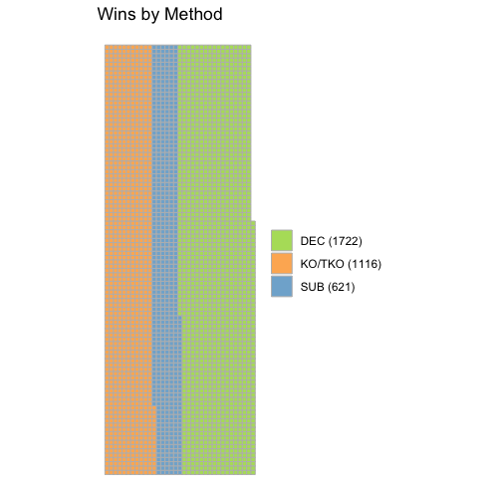
Win Method Distribution
Smallest amount of victories came from submissions
Could be attributed to the fact that fighters are becoming more well rounded as time goes on, resulting in less fighters that get caught in submissions due to lack of fundamental grappling knowledge
Largest amount of victories came by way of decision

Slide 5
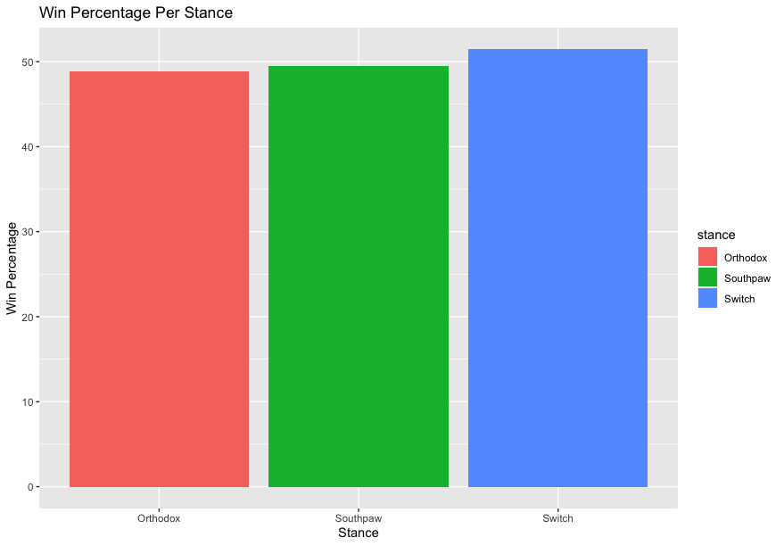
Wins by Stance
Relatively similar win percentage for each stance
Less than 3% difference between lowest and highest win percentages (orthodox and switch)
Disproves the old adage that southpaws are more likely to win fights
This might only be true at lower levels of competition, considering the UFC is the premier MMA league and generally has the most seasoned fighters

Slide 6
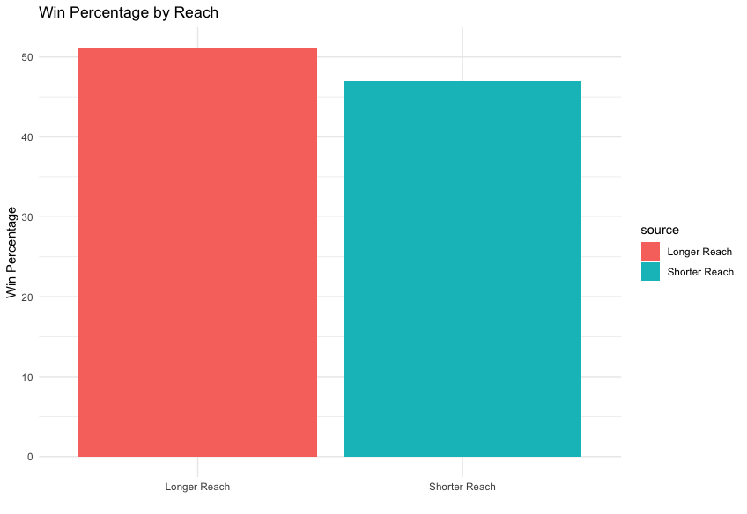
Reach Advantage
Wanted to see how beneficial having a reach advantage is to winning a fight
While not as big of a factor as is commonly thought, having a reach advantage did make fighters 5% more likely to win a bout

Slide 7
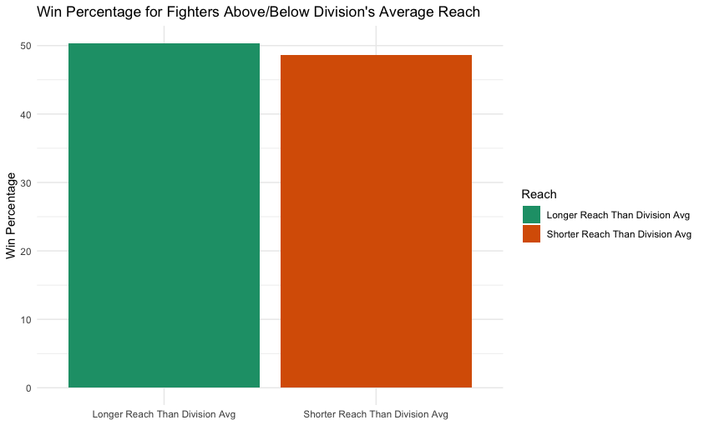
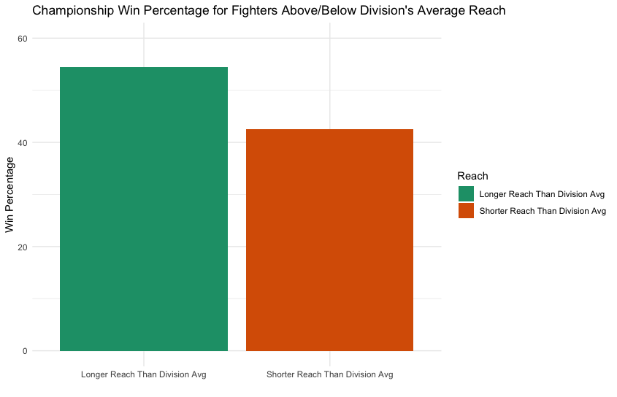
Reach Compared to Rest of Division

Slide 8
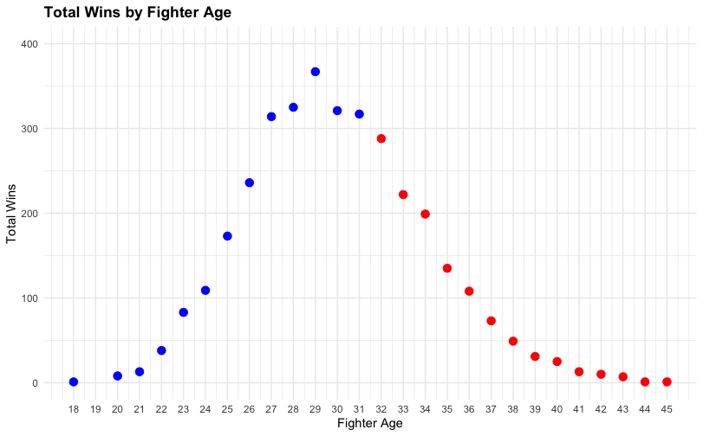
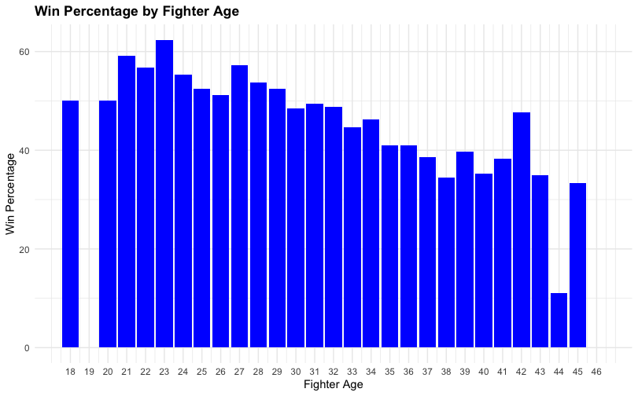
Wins by Fighter Age

Slide 9
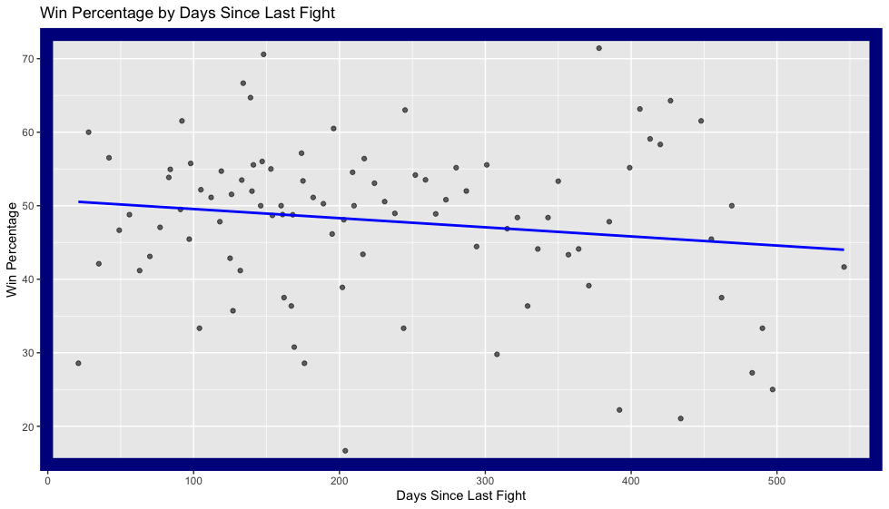
Win Percentage Based on Days Since Last Fight
Very slight inverse relationship between days between a fighter’s bouts and likeliness of winning
Idea of “ring rust” may have some truth to it, but it is not a drastic effect

Slide 10
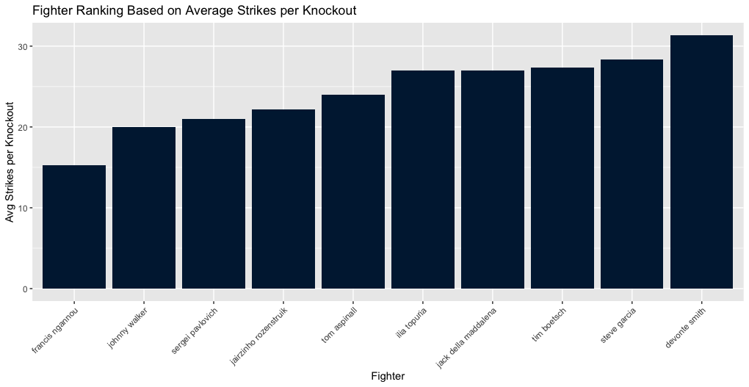
Average Punches per Knockout
Top 10 ranking of fighters based on fewest amount of strikes until they knock out their opponents on average
Some notable names here, but many of these fighters aren’t very dominant

Slide 11
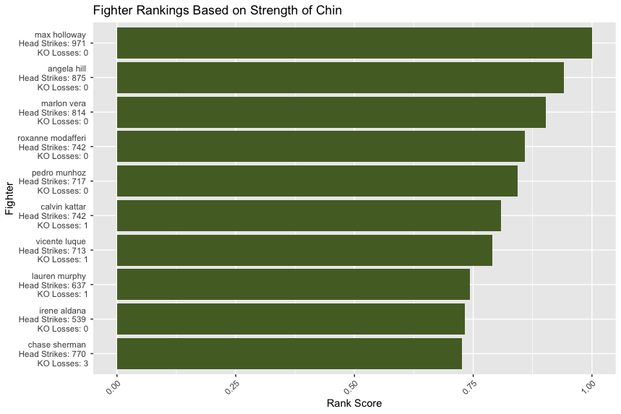
Strength of Chin
Resilience plays a large factor in fighter success
I wanted to rank fighters based on their ability to take strikes without succumbing
Fighters who received more strikes without being knocked out should receive a higher ranking than ones who were
But what about a fighter who received 700 strikes and was finished once vs a fighter who received 50 and wasn’t finished?
Created a rank score by multiplying head strikes received and knockout losses, with head strikes received ranked more heavily than KO losses

Slide 12
Q&A

